Slide 1
Lecture 2.
Stack and Queue
Instructor: 黄群
huangqun@pku.edu.cn
School of EECS
Peking University

Slide 2
Restricted Lists
Stack
Insertions and deletions can only be performed in one end (or the top)
Queue
Insert at the end of the list (rear)
Delete/access at the start of the list (front)

Slide 3
Today’s Outline
Stack (栈)
Operations & ADT
Implementations
Applications
Queue (队列)
Operations & ADT
Implementations
Applications

Slide 4
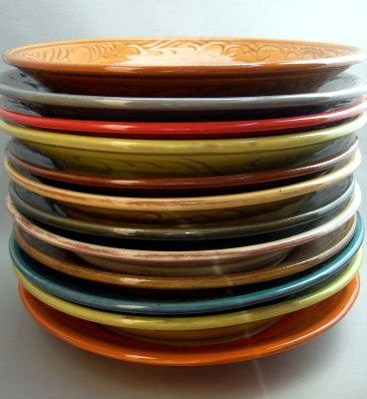
Stack
Last In First Out (LIFO)
access to the most recently added item only
a.k.a., push-down list, LIFO list
Major elements in a stack
Top element: the only accessible element
To insert an element is called “push”
To delete an element is called “pop”

Slide 5
Illustration of a Stack
The next element to be popped is the recently pushed element
The first element is at the bottom of stack
A stack without any element is called an “empty stack”
pop
push
top
k_{n-1}
...
k₁
bottom
k₀

Slide 6
Operations of a Stack
push
pop
top
empty (or size)

Slide 7
Stack ADT
template <class value_type>
class Stack {
public:
// insert a new element at the top
void push(const value_type& item);
// remove the element at the top
void pop();
// return a reference to the top element
value_type& top();
// test whether it is empty
bool empty();
// return the number of elements
size_type size();
};

Slide 8
Stack: Exercise
Intermixed push and pop operations
If the push operations put 0, 1, …, 9 in order onto the stack; the pop operations print out the return values, …
What are the possible sequences?
1 2 3 4 5 6 9 8 7 0
0 4 6 5 3 8 1 7 2 9
1 4 7 9 8 6 5 3 0 2
2 1 4 3 6 5 8 7 9 0

Slide 9
Solution: Simulate A Stack
Push order: 0 1 2 3 4 5 6 7 8 9
Pop order: 0 4 6 5 3 8 1 7 2 9
Impossible to pop “1”
6
4
5
5
8
3
3
3
3
7
7
2
2
2
2
2
2
0
1
1
1
1
1
1
Remain:
1-9
Remain:
5-9
Remain:
7-9
Remain:
7-9
Remain:
7-9
Remain:
9
Remain:
9

Slide 10
More General Solution
Assume output is p1, p2, …, pn
Impossible in output: there exist i < j < k, pj < pk < pi
1 2 3 4 5 6 9 8 7 0
0 4 6 5 3 8 1 7 2 9
1 4 7 9 8 6 5 3 0 2
2 1 4 3 6 5 8 7 9 0
Notes:
试证明：借助一个栈，要由输入序列1, 2, …, n得到输出序列p1, p2, …, pn（p1, p2, …, pn是1, 2, …, n的一种排列），则在输出序列中不可能出现如下情形：存在下标i＜j＜k，使得pj＜pk＜pi。
The 1st and 4th are possible, and the 2nd and 3rd are impossible.
https://en.wikipedia.org/wiki/Catalan_number
push, pop => x, y sequences
path in the lower-right part of a 2D mesh
C(2n,n) – C(2n,n+1).

Slide 11
Today’s Outline
Stack (栈)
Operations & ADT
Implementations
Applications
Queue (队列)
Operations & ADT
Implementations
Applications

Slide 12
Implementations of Stacks
Array-based stack (顺序栈)
Implemented by an array or vector, essentially an array-based list with restricted operations
Allocate sufficient space for the stack
Determine which end to be the top
Linked stack (链式栈)
Implemented by a singly linked list, where the pointers connect from top to bottom

Slide 13
Array-Based Stack
template <class T>
class ArrayStack : public Stack <T> {
private:
int max_size; // the maximum number of elements int top; // top position (top < max_size)
T* st; // the array of elements
public:
ArrayStack(int size) { // given the maximum size
max_size = size;
top = -1;
st = new T[max_size];
}
~ArrayStack() { delete [] st; }
}

Slide 14
Array-Based Stack
The recent element pushed is 4, and the less recent elements are 3, 2, 1
top
4
3
2
bottom
1

Slide 15
Illustration of an Array-Based Stack
5
5
s.top = 5
5
F
5
4
4
4
E
4
3
D
s.top = 3
3
3
3
D
2
2
2
C
2
C
1
1
1
B
1
B
0
s.top = 0
0
A
0
A
0
A
s.top = -1

Slide 16
Overflow/Underflow of Stacks
Overflow (上溢)
To perform a push in a full stack (array-based)
Underflow (下漏)
To perform a pop in an empty stack (either array-based or linked)

Slide 17
Push Operation
void ArrayStack<T>::push(const T& item) {
// check overflow
if (top+1 >= max_size) {
cerr << ”overflow" << endl;
assert(false);
}
// push a new element, and
// update the top position
st[++top] = item;
}

Slide 18
Pop Operation
void ArrayStack<T>::pop() {
// check underflow
if (top < 0) {
cerr << “empty stack” << endl;
assert(false);
}
// pop the top element, and
// update the top position
item = st[top--];
}

Slide 19
Access the Top Element
T& ArrayStack<T>::top() {
// check empty stack
if (top < 0) {
cerr << ”empty stack"<< endl;
assert(false);
}
item = st[top]; // return the top element
}

Slide 20
Other Operations
// return the number of elements
size_type ArrayStack<T>::size() {
return (top+1);
}
// return true if the stack is empty
bool ArrayStack<T>::empty() {
return size()==0;
}

Slide 21
Linked Stack
data
next
Implemented by a singly linked list
The pointers point from the top to the bottom
k_{i+2}
top
k_{i+1}
k_{i}
k₀
^

Slide 22
Creation of a Linked Stack
template <class T>
class LinkedStack : public Stack <T> {
private:
LinkNode<T>* top; // a pointer to the top node
int size; // the size of the stack
public:
LinkedStack(int defSize) { // constructor
top = NULL;
size = 0;
}
~LinkedStack() { // deconstructor
clear();
}
}

Slide 23
Push Operation
void LinkedStack<T>::push(const T& item) {
LinkNode<T>* tmp =
new LinkNode<T>(item, top);
top = tmp;
size++;
}

Slide 24
Pop Operation
void LinkedStack<T>::pop() {
LinkNode <T> *tmp;
if (size == 0) { // check emptiness
cerr << “empty stack” << endl;
assert(false);
}
tmp = top->next; //save the new top
delete top; // release the old top
top = tmp; // set the new top
size--; // decrease the stack size
}

Slide 25
Comparison of Array-Based Stack and Linked Stack
Time efficiency
All operations are in O(1)
No big difference
Space efficiency
Array-based stacks must estimate the size of array
Linked stacks support variable lengths, but have structural overhead

Slide 26
Comparison of Array-Based Stack and Linked Stack
In practice, array-based stacks are more widely used than linked stacks
Low storage overhead
Array-based stacks can quickly locate and access the internal elements
The access time is O(1) for array-based stacks, but the linked stacks take O(k) time to access the k-th element from the top
Generally, “access internal elements” are not allowed

Slide 27
Today’s Outline
Stack (栈)
Operations & ADT
Implementations
Applications
Queue (队列)
Operations & ADT
Implementations
Applications

Slide 28
Applications of Stacks
Number system conversion
Evaluating expressions
Managing subprogram/function call
Eliminating recursions
Depth-first search

Slide 29
Number System Conversion
To convert a nonnegative decimal number to a representation in other number systems
For example, to convert a decimal number to an octal number: (66)₁₀=(102)₈
66 / 8 = 8 remainder 2
8 / 8 = 1 remainder 0
1 / 8 = 0 remainder 1
The result is a reversed order of the remainders: 102
Notes:
draw a stack on blackboard to show the process

Slide 30
Symbol Matching
Braces, parentheses, brackets, begin, ends must match each other
[ { [ ( ) ] } ]
[ { ] } ( )
Easy check using stacks

Slide 31
Example
Check brace, bracket parentheses matching
[a+b{1*2]9*1}+(2-1)
Push [, Push {, Pop, Pop, Push (, Pop
Get {
{
[
[
[
Push [
Push {
Pop
Oops! Something wrong, was expecting [

Slide 32
Symbol Matching
Start from beginning of the string
When encountering a opening symbol
Push the opening parenthesis/bracket/brace in the stack, and ignore the alphabets
When encountering a closing symbol
If stack is empty, report an error
Pop an element from the stack
If it is the corresponding opening symbol, fine
Otherwise, report an error
What is the complexity of the operation?
O(n)

Slide 33
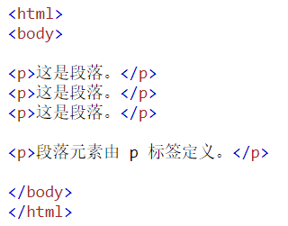
Another Example: HTML
Check whether HTML labels are correct

Slide 34
Arithmetic Expressions
Infix expression
Prefix expression
a parentheses-free expression
a.k.a., Polish (Warsaw) notation
[Lukasiewicz, 1929]
Postfix expression
a.k.a., reverse Polish notation
[Hamblin, 1957]

Slide 35
Evaluating Expressions
Infix expressions
23 + (34 * 45) / (5 + 6 + 7)
Postfix expressions
23 34 45 * 5 6 + 7 + / +

Slide 36
Evaluating Infix Expressions
‘(‘ and ‘)’ have the highest precedence
‘*’, ‘/’ have lower precedence than ‘(’, ‘)’
‘+’, ‘-’ have lower precedence than ‘*’, ‘/’
Operations of the same precedence in an expression are performed from left to right
23 + (34*45) / (5+6+7) = ?
Human readable, but not friendly for computers

Slide 37
Evaluating Postfix Expressions
23 34 45 * 5 6 + 7 + / + = ?
Loop: read the symbol sequence of the expression (assuming ended with ‘=’), and analyze according to the current symbol being read
If it is an operand, push it in the stack
If it is an operator, pop two elements, compute the result with this operator; and then push the result in the stack
Repeat until the symbol ‘=’ is read.
The top element is the value of the expression
Simple for computers

Slide 38
Example
Postfix Expression：
23
34
45
*
5
6
＋
7
＋
/
＋
11
18
1530
108
Stack
85
Calculation

Slide 39
Converting Infix to Postfix
(1) Initialize a stack.
(2) Read a symbol
(2.1) If it is an operand, place onto the output.
(2.2) If it is an operator
(a) If it is a closing parenthesis, then pop the stack, write symbols, until an opening parenthesis is encountered.
Remark: The '(' is popped, but not written as output.
(b) If it is any other symbol, such as '+', '*', '(', pop entries from the stack until an entry of lower priority is found, or '(' is found. When the popping is done, push the operator onto the stack.
(3) Goto step (2).
(4) When reach the end of input, pop the stack until it is empty, and write symbols to the output.

Slide 40
Evaluating Expressions
Infix expression
Postfix expression
Stack
23
＋
(
34
*
45
)
/
(
5
-
6
＋
7
)
＋
-
(
*
/
(
23
34
45
*
5
6
-
7
＋
/
＋
＋

Slide 41
Recommended Readings
Weiss, “DS & Algo. Analysis in C++” (3rd ed.)
Section 3.6.1 Stack Model
Section 3.6.2 Implementation of Stacks
Section 3.6.3 Applications
“A brief history of the stack”, Sten Henriksson
Source code
https://github.com/gcc-mirror/gcc/blob/master/libstdc%2B%2B-v3/include/bits/stl_stack.h

Slide 42
Outline
Stack (栈)
Operations & ADT
Implementations
Applications
Queue (队列)
Operations & ADT
Implementations
Applications

Slide 43
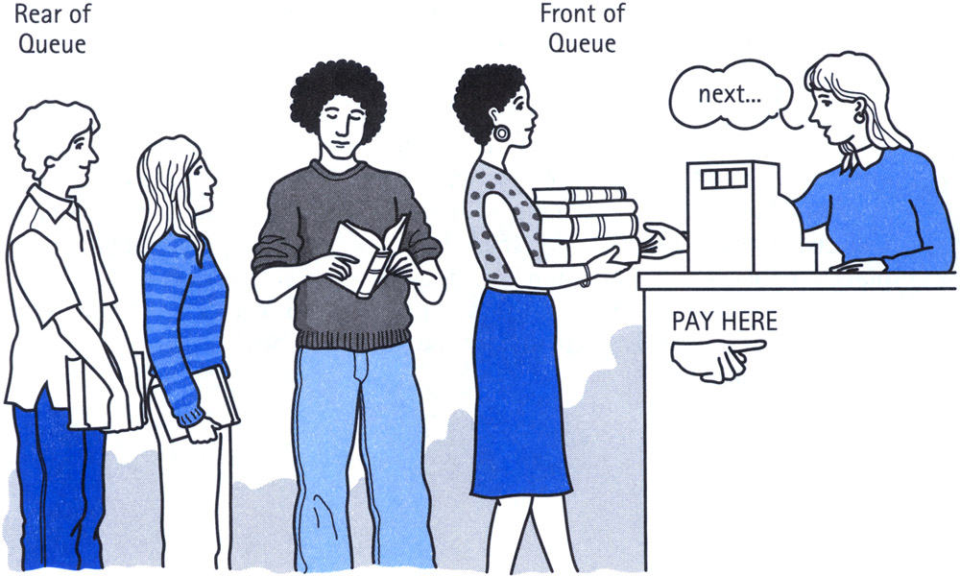
Queue
http://therabbitway.com/blog/2013/01/18/the-rabbit-ways-6-step-productivity-system/fifoqueue/
Notes:
[BE] jump the queue; [AE] cut the line

Slide 44
Illustration of a Queue
dequeue
k₀ k₁ k₂ …. k_{n-1}
enqueue
front
rear
The end for deletion is the front
The other end for insertion is the rear
Empty queue: a queue without any element

Slide 45
Queue Definition
First In, First Out (FIFO)
A list with restricted access
Release elements in the order of arrival
Insertion at one end
Deletion at the other end
Major elements
Front
Rear

Slide 46
Operations of a Queue
enqueue()
dequeue()
front()
isEmpty() or length()

Slide 47
Queue ADT
template <class T> class Queue {
public:
// insert an element at the rear
bool enqueue(const T item);
// remove an element at the front
bool dequeue(T& item);
// a reference to the front element
bool front(T& item);
// the #elements in the queue
int length();
};

Slide 48
Outline
Stack (栈)
Operations & ADT
Implementations
Applications
Queue (队列)
Operations & ADT
Implementations
Applications

Slide 49
Implementation of Queues
Array-based queue
How to avoid false overflow?
(will be explained soon)
Linked queue
Implemented as a singly linked list

Slide 50
Array-Based Queue
Implemented by array-based list
Store elements in an array
Two extra variables to indicate the front and rear

Slide 51
Array-Based Queue
Q.front
Q.rear
Q.front
0
k₀
1
k₁
2
k₂
3
Q.rear
4
Q.front
5
k₄
6
k₅
7
Q.rear
empty
queue

Slide 52
Queue Overflow & Underflow
Overflow
Trying to insert an element onto a full queue
Underflow
Trying to delete an element from an empty queue
False overflow
Trying to enqueue an element when
rear == array_size, but
there are still empty slots before front

Slide 53
Definition of Array-Based Queue
class arrQueue: public Queue<T> {
private:
int mSize; // the array size
int front; // the index of the current front
int rear; // the index of the next rear
T *qu; // an array of type T
public:
arrQueue(int size) {
mSize = size +1; // to distinguish a full queue from an empty queue
qu = new T [mSize];
front = rear = 0;
}
~arrQueue() {
delete [] qu;
}
}

Slide 54
Enqueue a New Element
front
front
1
1
2
2
enqueue 5
3
3
4
4
rear
5
rear

Slide 55
Array-Based Queue: Enqueue
bool arrQueue<T> :: enqueue(const T item) {
if (((rear + 1 ) % mSize) == front) {
cout << ”warning: queue is full" << endl;
return false;
}
qu[rear] = item;
rear = (rear +1) % mSize; // circular successor
return true;
}

Slide 56
Array-Based Queue: Dequeue
bool arrQueue<T> :: dequeue(T& item) {
if ( front == rear) {
cout << ”warning: queue is empty" << endl;
return false;
}
item = qu[front];
front = (front +1) % mSize;
return true;
}

Slide 57
Example of Queue Operations
front
front
front
rear
1
1
rear
2
3
4
rear
front
rear

Slide 58
Example of Queue Operations
8
9
front
rear
rear
front
front
5
5
rear
6
7

Slide 59
Linked Queue
A singly linked queue
Nodes are linked from the front to the rear
f
r
….
^
k₀
k₁
k₂
k_{n-1}

Slide 60
Definition of Linked Queue
template <class T>
class LnkQueue: public Queue <T> {
private:
int size; // the number of elements in the queue
Link<T>* front; // the node at the front
Link<T>* rear; // the node at the rear
public:
LnkQueue(int size) {
size = 0;
front = rear = NULL;
}
~LnkQueue() {
clear();
}
}

Slide 61
Linked Queue: Enqueue
bool LnkQueue <T> :: enqueue(const T item) {
if (rear == NULL) { // check empty queue
front = rear = new Link<T> (item, NULL);
}
else { // enqueue
rear-> next = new Link<T> (item, NULL);
rear = rear ->next;
}
size++;
return true;
}

Slide 62
Linked Queue: Dequeue
bool lnkQueue <T> :: dequeue(T& item) {
Link<T> *tmp;
if (size == 0) { // check empty queue
cout << ”empty queue" << endl;
return false;
}
item = front->data;
tmp = front;
front = front -> next;
delete tmp;
if (front == NULL)
rear = NULL;
size--;
return true;
}

Slide 63
Comparison of Array-Based Queue and Linked Queue
Array-based queue
A fixed-size of space
Direct access to internal elements
Linked queue
Adaptive to handle massive enqueue operations in a short period
No direct access to internal elements

Slide 64
Outline
Stack (栈)
Operations & ADT
Implementations
Applications
Queue (队列)
Operations & ADT
Implementations
Applications

Slide 65
Real-World Applications
The FIFO property
Scheduling and buffering
Message buffering
Email buffering
Communications between devices
Resource management in OS
Breath-first search (BFS)

Slide 66
Queue with find_min in O(1)
Return the min value of the queue (without removing it)

Slide 67
Queue with find_min in O(1)
Return the min value of the queue (without removing it)
Hint-1: simulate a queue with stack(s)
Hint-2: find_min for stack?
Hint-3: Implement queue using two stacks
Complexity analysis
How many enqueue/dequeue operations?
How many comparisons in the min deque?
Amortized complexity is O(1)

Slide 68
Variant 1: Double-ended queue (deque)
Insertion/deletion are restricted at both ends
Insert
Front
Back
Insert
Delete
Delete
Notes:
http://stackoverflow.com/questions/685060/design-a-stack-such-that-getminimum-should-be-o1
http://www.mail-archive.com/algogeeks@googlegroups.com/msg18893.html

Slide 69
Applications of Deque
Undo / Redo
Web browsing history

Slide 70
Variant 2: Circular Queue
Q.front
Q.front
Q.rear
k₂
k₁
Q.rear
k₃
k₄
k₇
k₅
k₆
Empty queue:
Q.rear == Q.front
Full queue:
(Q.rear+1) mod M
== Q.front
Notes:
Q: What the queue is full when the array is not full?

Slide 71
Circular Queue: Implementation
Q.rear
k₄
Q.rear
k₅
Q.front
k₆
Q.rear
Q.front
k₀
Q.front
k₁
k₄
k₂
k₅
k₃
k₆
empty queue
full queue

Slide 72
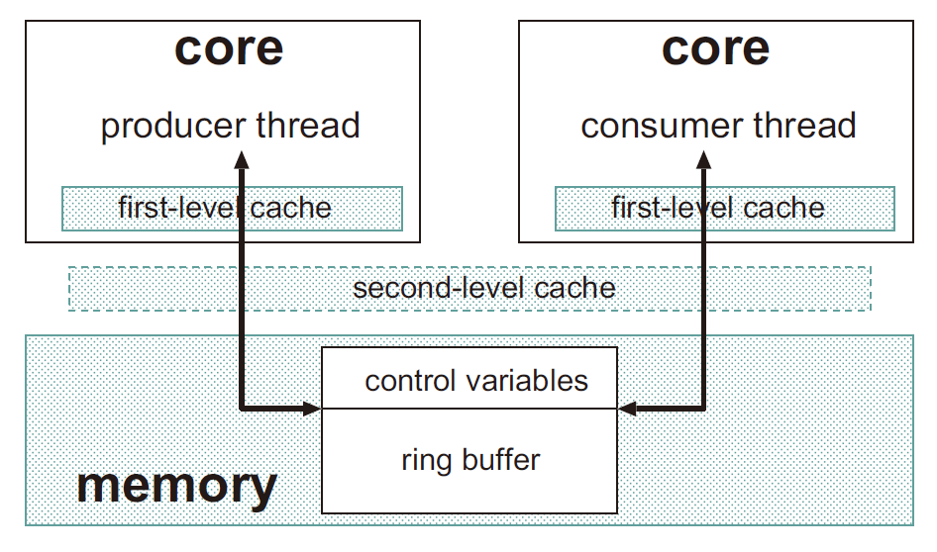
Inter-Thread Communication: Lock Free
Write (Q.front) by producer
Read (Q.rear) by consumer

Slide 73
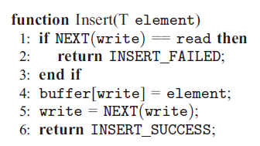
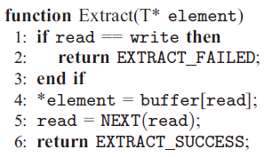
Inter-Thread Communication: Lock Free
https://ieeexplore.ieee.org/document/5470368

Slide 74
Optimize Common Variables in Cache
Write (Q.front) by producer
Read (Q.rear) by consumer
https://ieeexplore.ieee.org/document/5470368

Slide 75
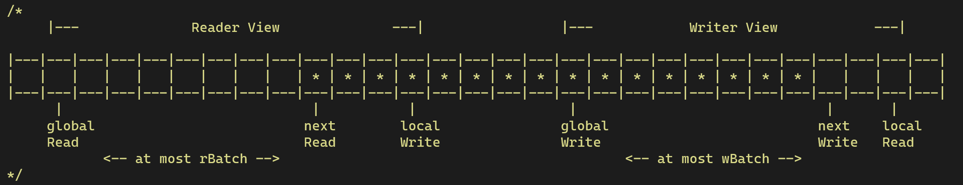
Optimize Common Variables in Cache
Global Barriers
(Lazy Update)
Thread-Local Pointers
(L1 Cache)
Thread-Local Barriers
(L1 Cache + Lazy Update)
https://ieeexplore.ieee.org/document/5470368

Slide 76
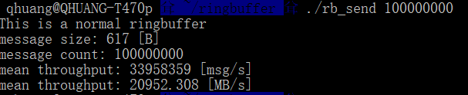

Results
10^7 messages, each has 617 bytes
<30ns for each message
>160 Gbps throughput

Slide 77
Recommended Readings
Weiss, “DS & Algo. Analysis in C++” (3rd ed.)
Section 3.7.1 Queue Model
Section 3.7.2 Array Implementation of Queues
Section 3.7.3 Applications of Queues
Source code
https://github.com/gcc-mirror/gcc/blob/master/libstdc%2B%2B-v3/include/bits/stl_queue.h

Slide 78
Summary
Stack
Last In, First Out (LIFO)
Implementations: array-based and linked based
Applications
Queue
First In, First Out (FIFO)
Implementations: array-based and linked based
Applications

Slide 79
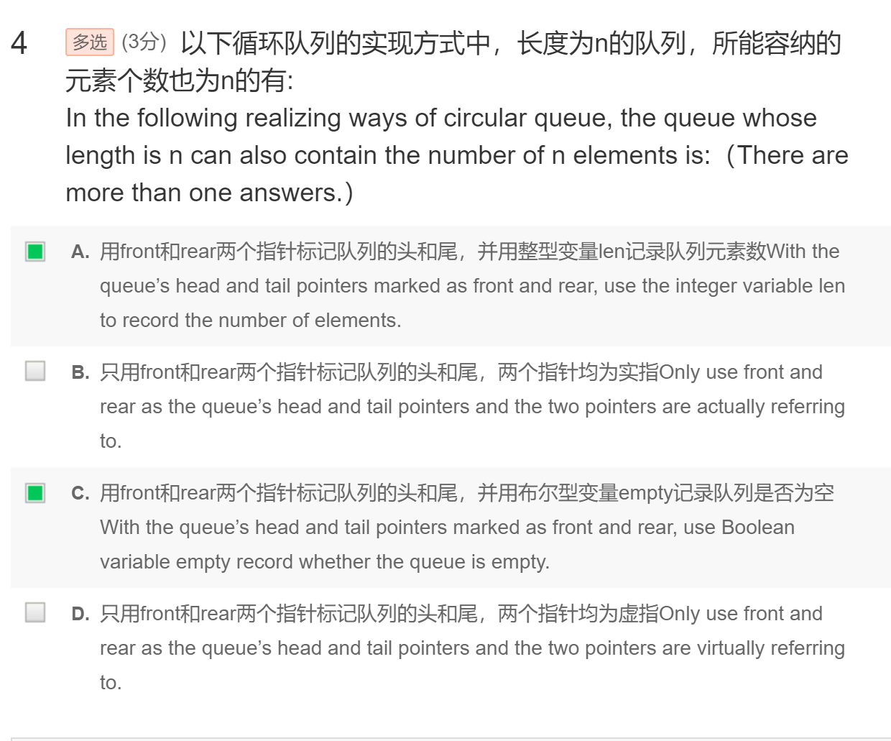
More Notes: 虚指、实指

Slide 80
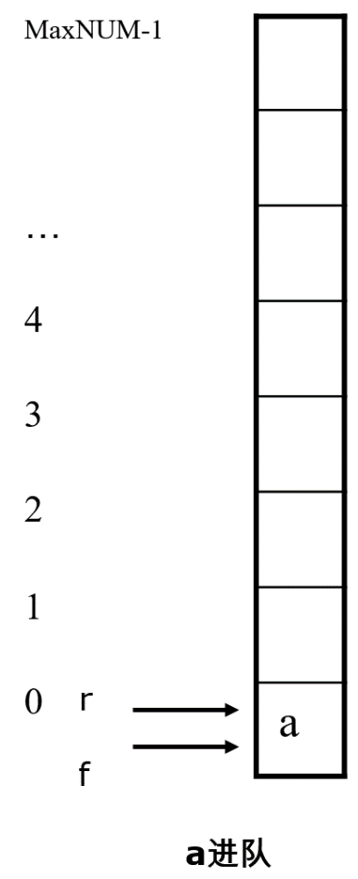
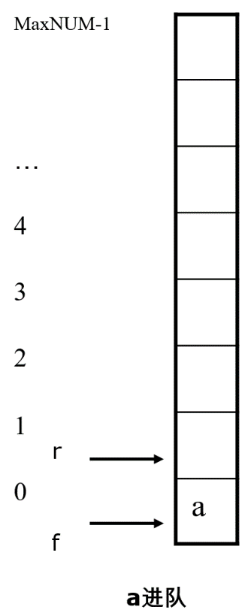
More Notes: 虚指、实指
虚指： rear 尾指针指向下一个准备入队的空位置
实指， rear 尾指针指向队尾（空队列的处理）

